Slide 1
Student Performance IN EXAM
.

Slide 2

Elakanti Akhil Kumar
2203A52149
TRAINER: Mr. D. Ramesh Asst. professor
CS and AI&ML

Slide 3
INTRODUCTION
Education is a cornerstone of personal development and societal progress. A critical aspect of evaluating the effectiveness of educational systems is assessing student performance. This multifaceted concept encompasses not only academic achievements but also factors such as attendance, engagement, and overall well-being.

Slide 4
DATA INSIGHTS
1)Students
2)Grades
3)Course ID

Slide 5
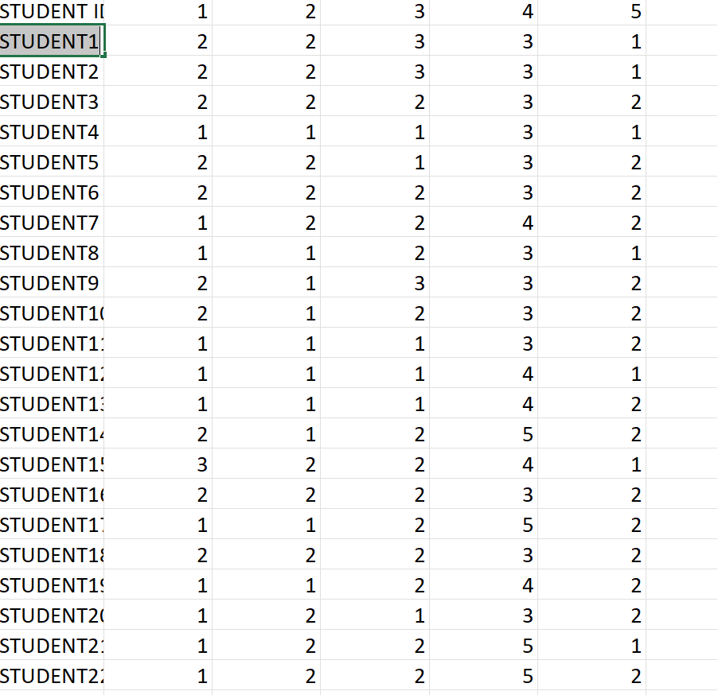
DATASET

Slide 6
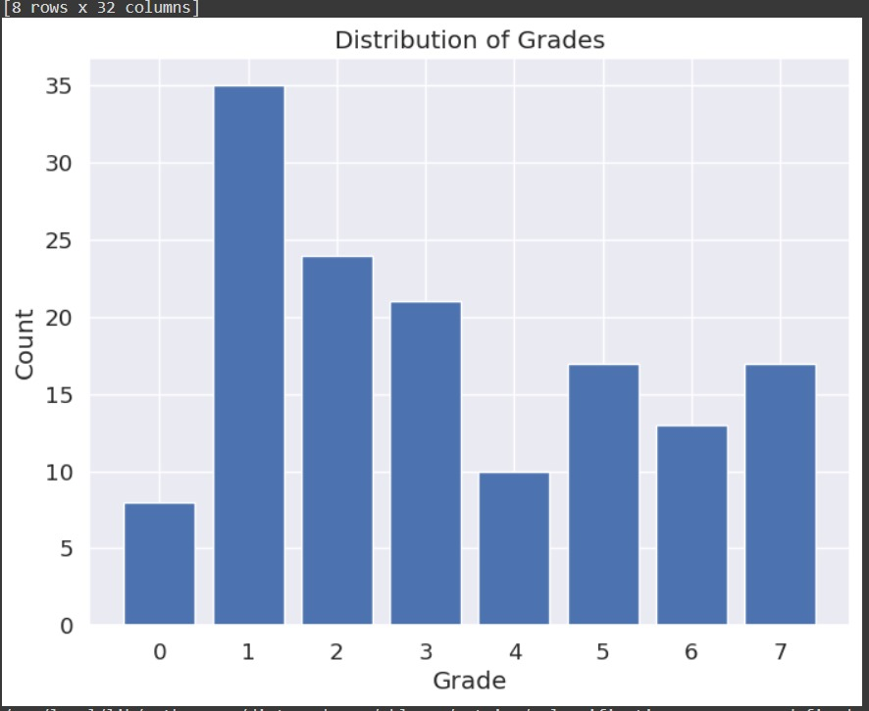
GRAPH​

Slide 7
LOGISTIC REGRESSION
LOGISTIC REGRESSION:-
Logistic regression is a supervised machine learning algorithm mainly used for classification tasks where the goal is to predict the probability that an instance of belonging to a given class or not. It is a kind of statistical algorithm, which analyze the relationship between a set of independent variables and the dependent binary variables. It is a powerful tool for decision-making.

Slide 8
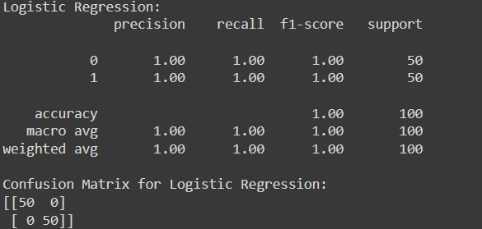
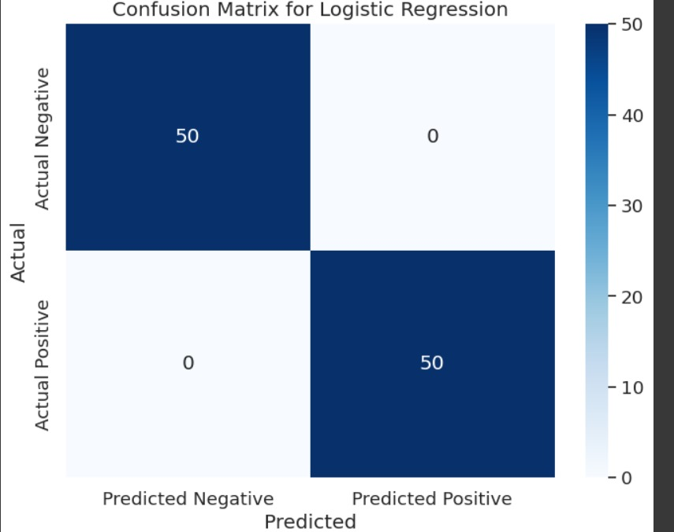
OUTPUT

Slide 9
SVM(support vector MACHINE)
The aim of a support vector machine algorithm is to find the best possible line, or decision boundary, that separates the data points of different data classes. This boundary is called a hyperplane when working in high-dimensional feature spaces. The idea is to maximize the margin, which is the distance between the hyperplane and the closest data points of each category, thus making it easy to distinguish data classes.

Slide 10
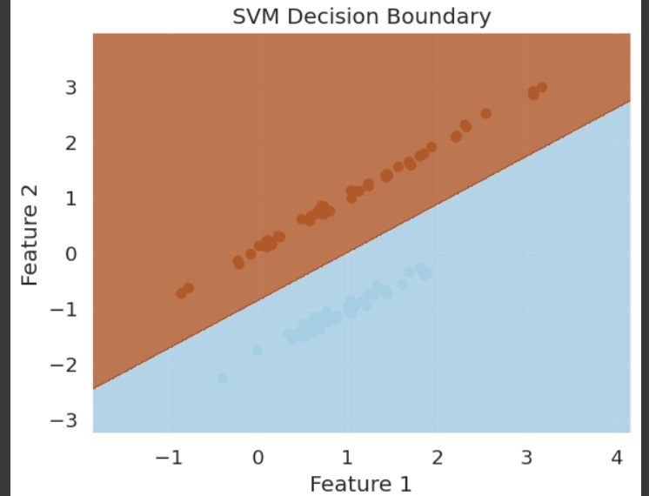
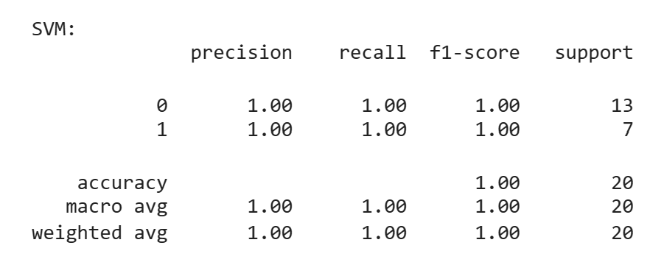
OUTPUT

Slide 11
PERCEPTRON
Perceptron is Machine Learning algorithm for supervised learning of various binary classification tasks. Further, Perceptron is also understood as an Artificial Neuron or neural network unit that helps to detect certain input data computations in business intelligence.

Slide 12
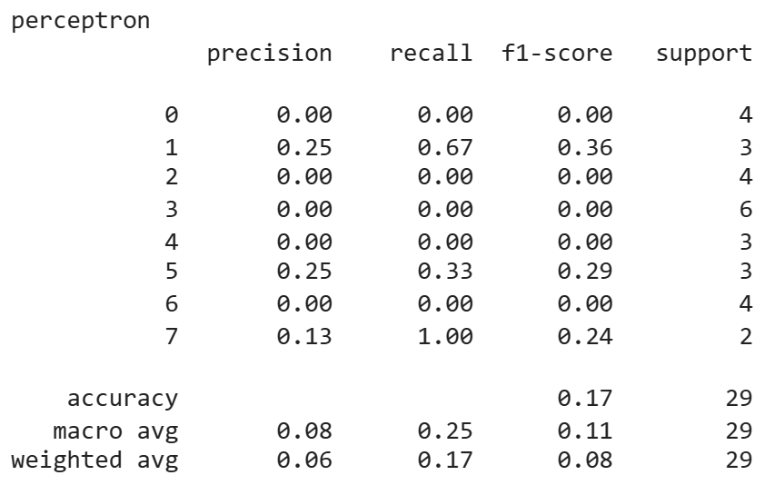
OUTPUT

Slide 13
LASSO REGRESSION
Lasso regression, short for "Least Absolute Shrinkage and Selection Operator," is a linear regression technique that adds a penalty term to the loss function, promoting feature selection by shrinking some coefficients to zero. It helps prevent overfitting and simplifies the model.

Slide 14
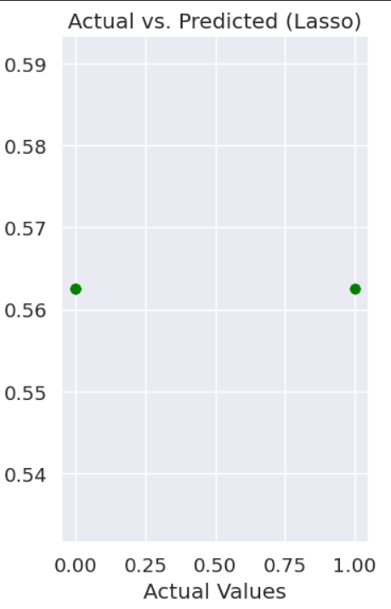

OUTPUT OF LASSO REGRESSION

Slide 15
RIDGE REGRESSION
Ridge Regression is a linear regression technique that introduces L2 regularization by adding a penalty term to the least squares objective, helping prevent overfitting in the presence of multicollinearity.

Slide 16
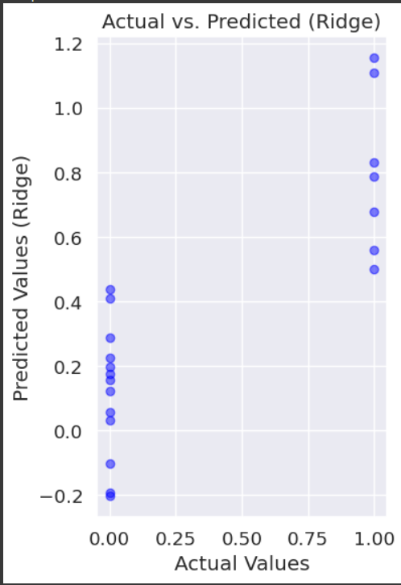

OUTPUT OF RIDGE REGRESSION

Slide 17
KNN REGRESSION
k-Nearest Neighbors (k-NN) regression is a supervised machine learning algorithm that predicts the target value of a data point by averaging the values of its k nearest neighboring data points. It's used for regression tasks to estimate numerical outcomes based on the similarity of neighboring data points.

Slide 18
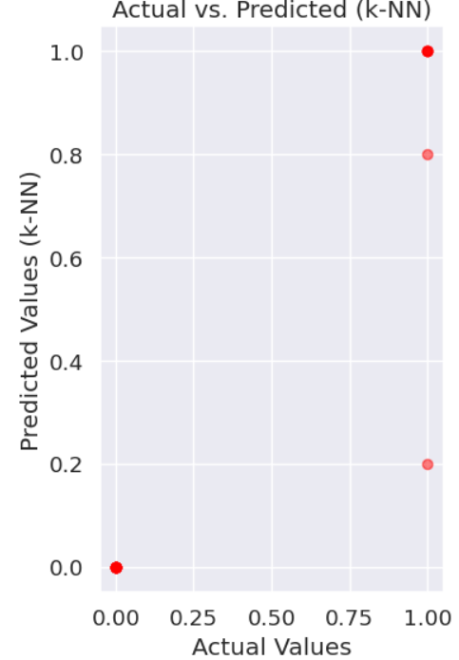

OUTPUT OF KNN REGRESSION

Slide 19
GITHUB LINK:https://github.com/EAkhilkumar/2203A52149-CAPSTONE-PROJECT-STAT_ML-REVIEW-2-.git

Slide 20
THANK YOU

